Slide 1
Run away to Africa
December 2012

Slide 2
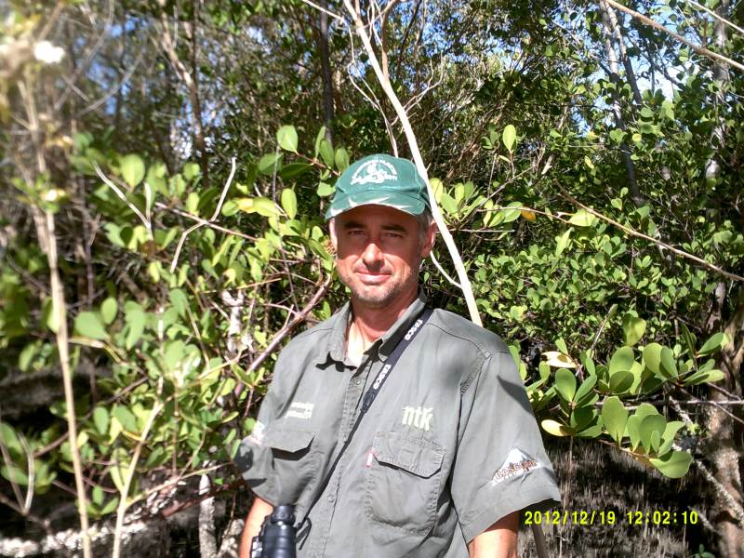
Introduction
Kenny Fagan
-Farm Manager
-Current: Pig and cattle farm.
-Past: Dairy, Show cattle, Lodge maintenance.
-Cedara Agricultural college
-General Smuts High School
-Born in Durban

Slide 3
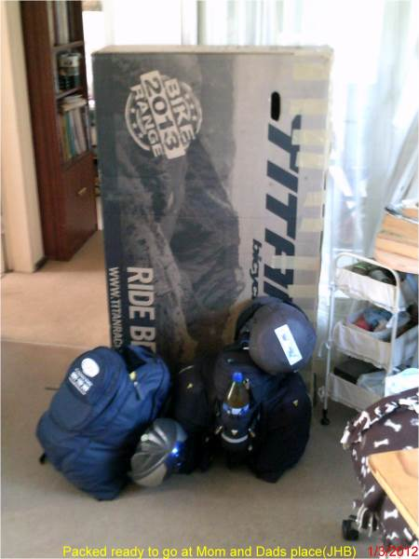
Pre trip planning
Speaking to people with experience.
Working out a route.
Booking tickets
Getting gear.
Planning food and water.
Packing.
Type of cycling.pptx
Gear.pptx

Slide 4
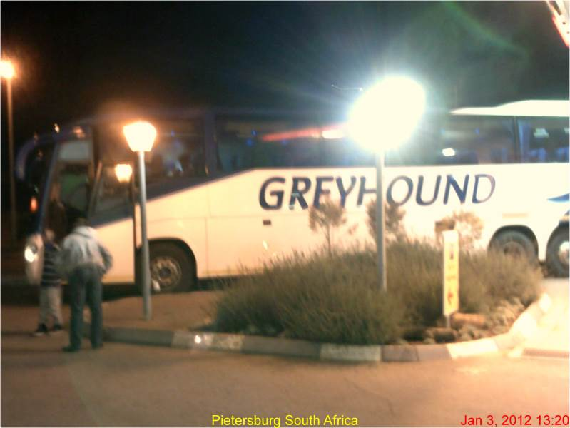
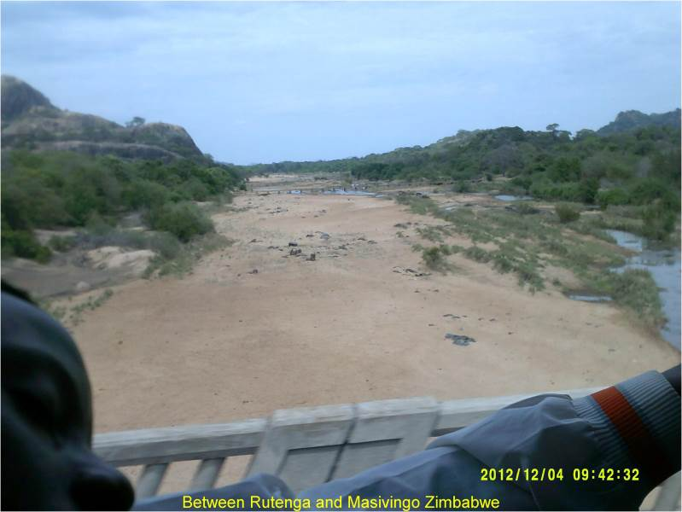
Bus trip

Slide 5
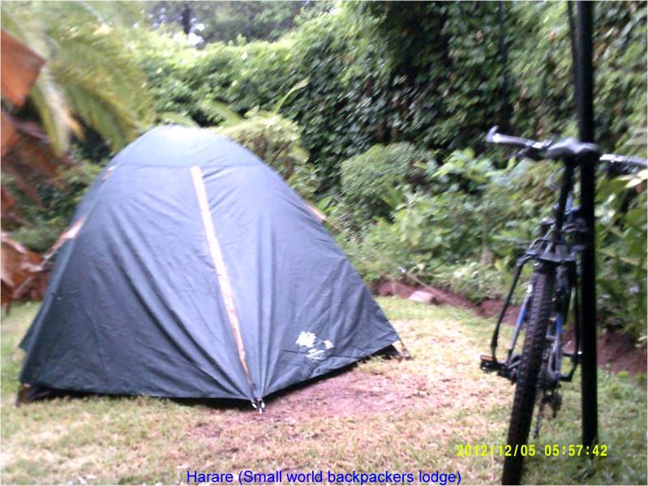
Harare budget accommodation

Slide 6
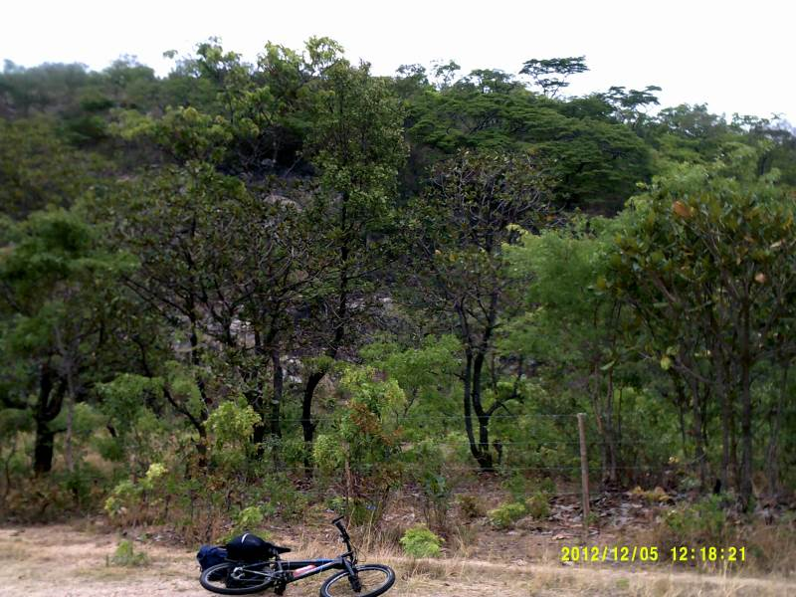
Harare to Mt Darwin

Slide 7
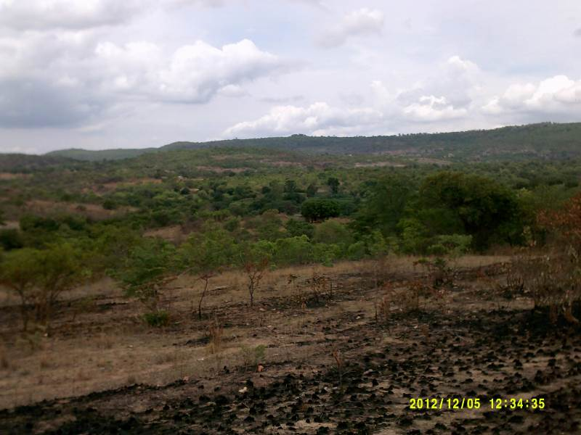

Slide 8
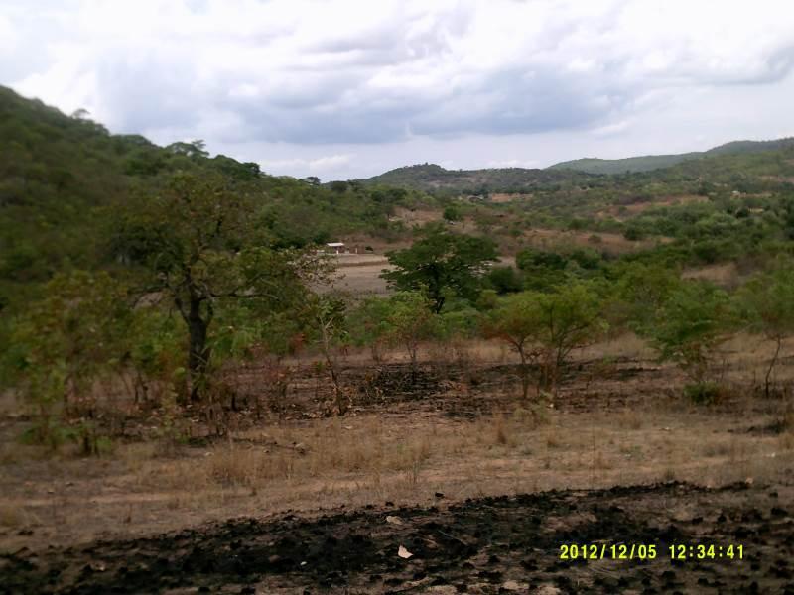
Small Farms

Slide 9
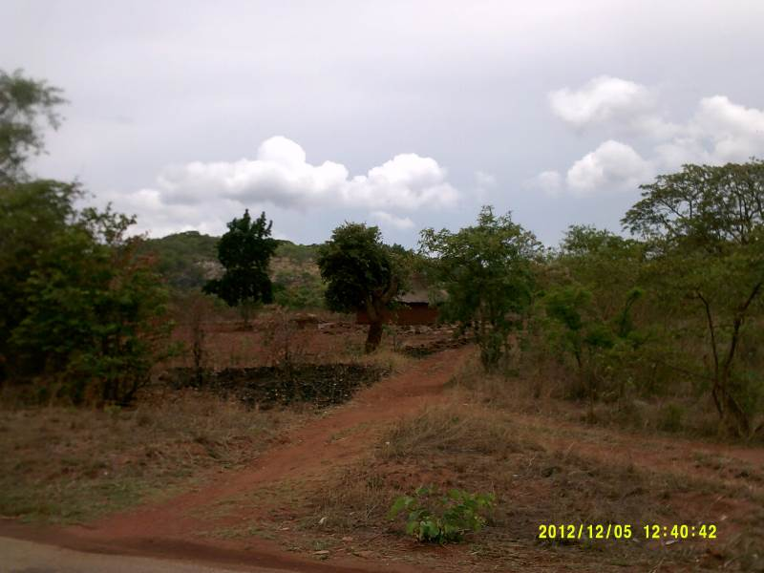
Brick Houses

Slide 10
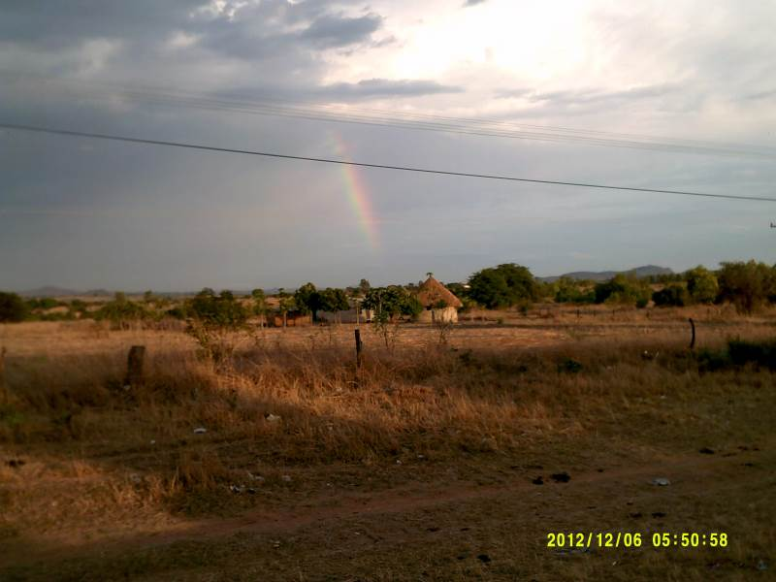
Morning after sleeping at police station

Slide 11
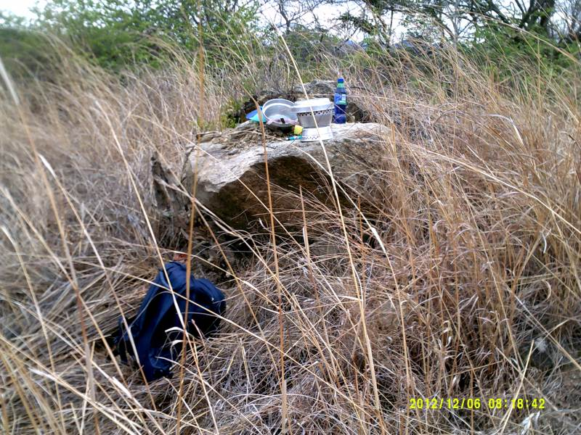
Road side cooking

Slide 12
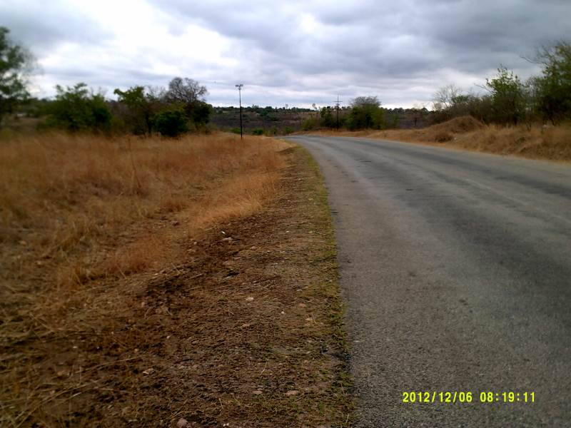
Good tar road almost finished

Slide 13
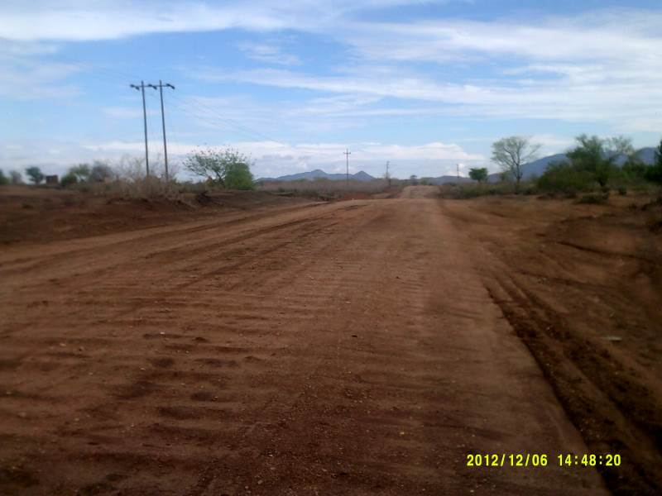
Flood plane before Mukumbura boarder post

Slide 14
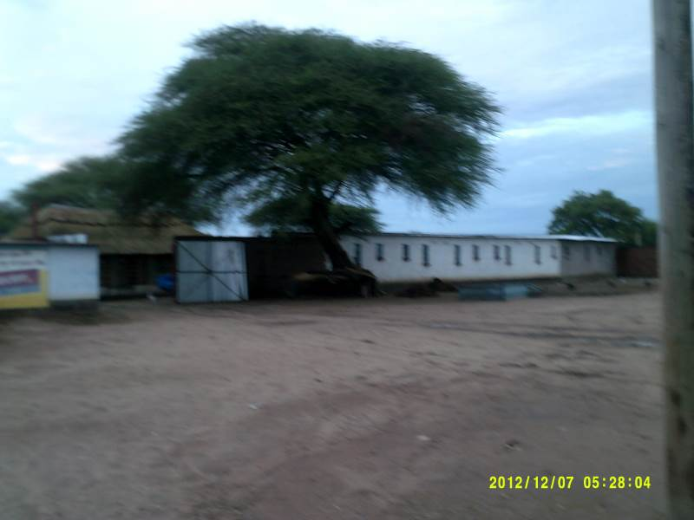
Welcome to Mukumbura town

Slide 15
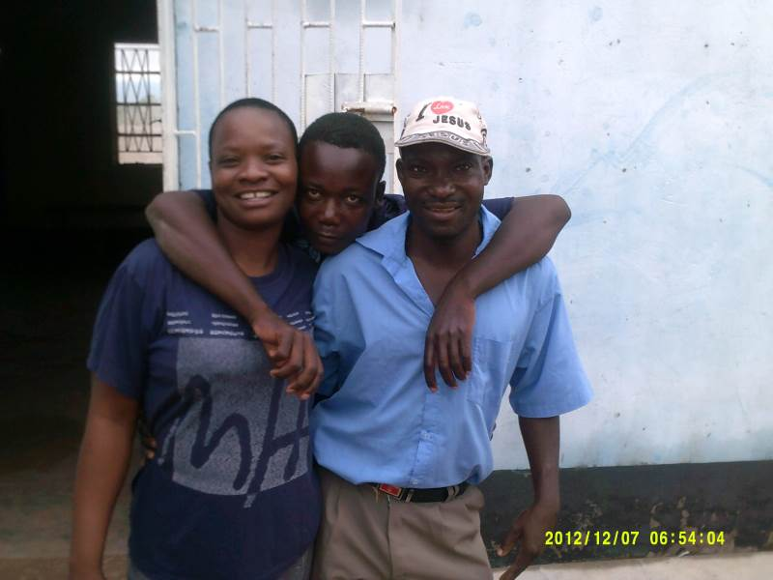
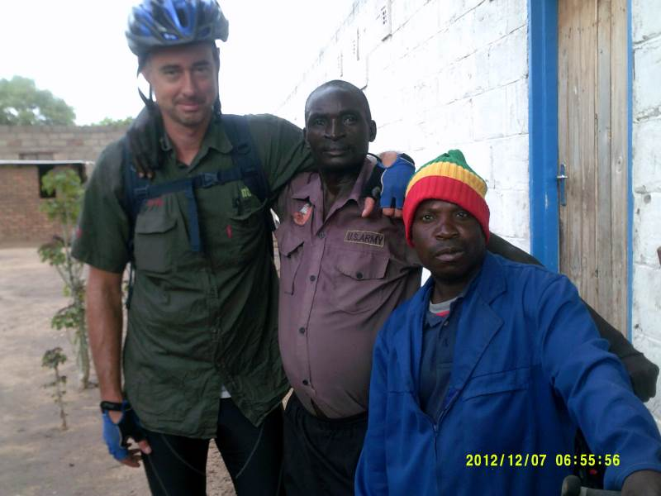
Friendly hosts

Slide 16
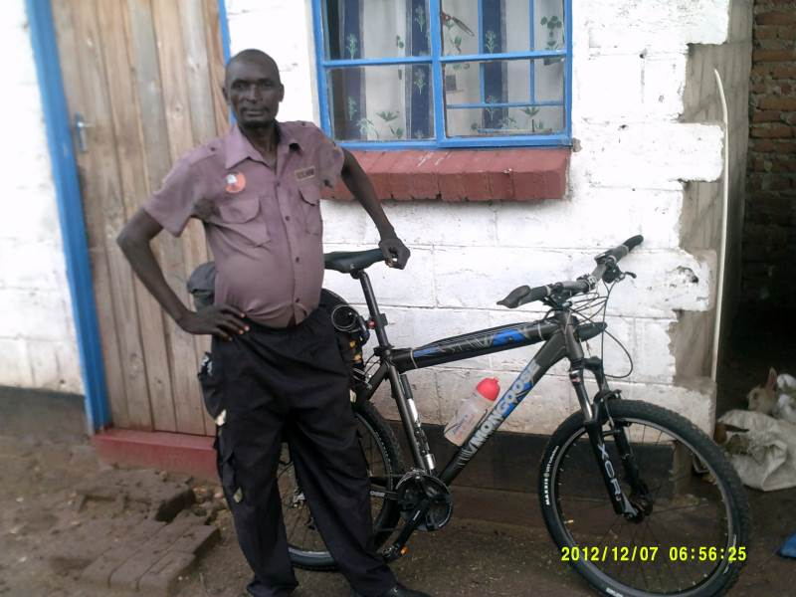
Special man

Slide 17
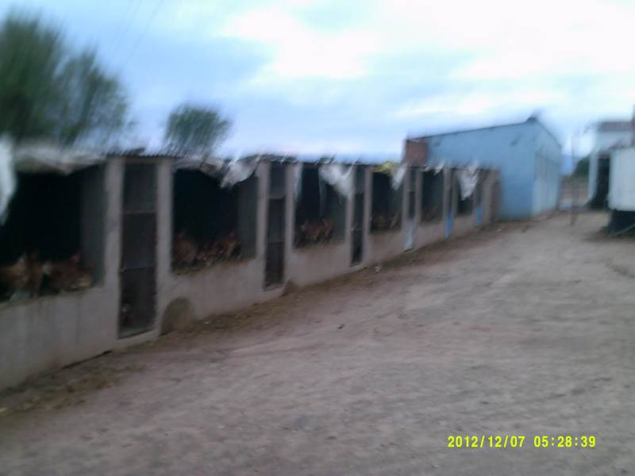
Egg laying unit

Slide 18
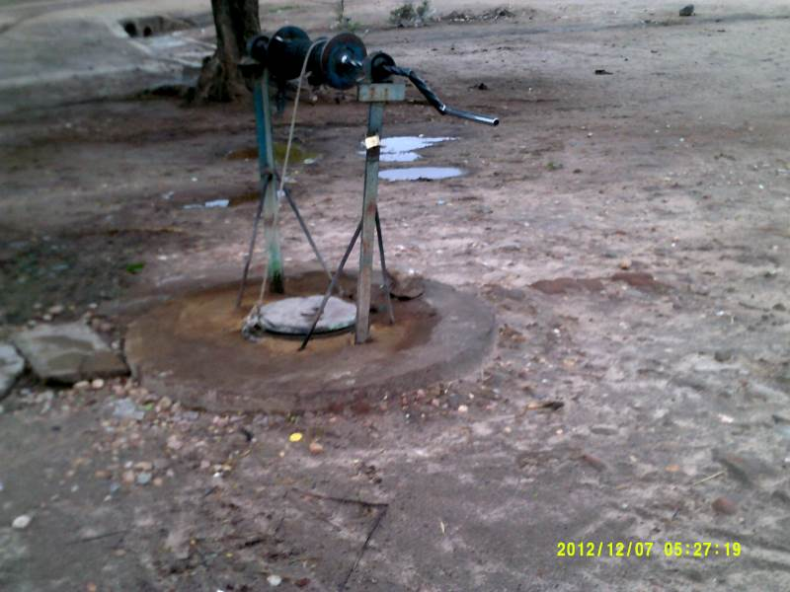
Town water supply

Slide 19
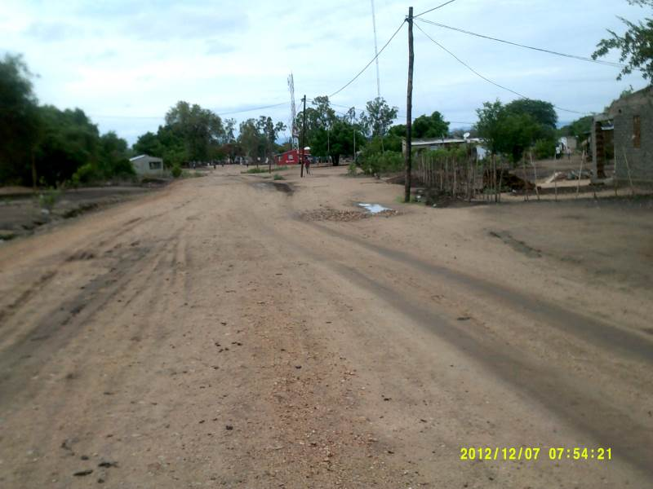
Cross boarder in Mozambique

Slide 20
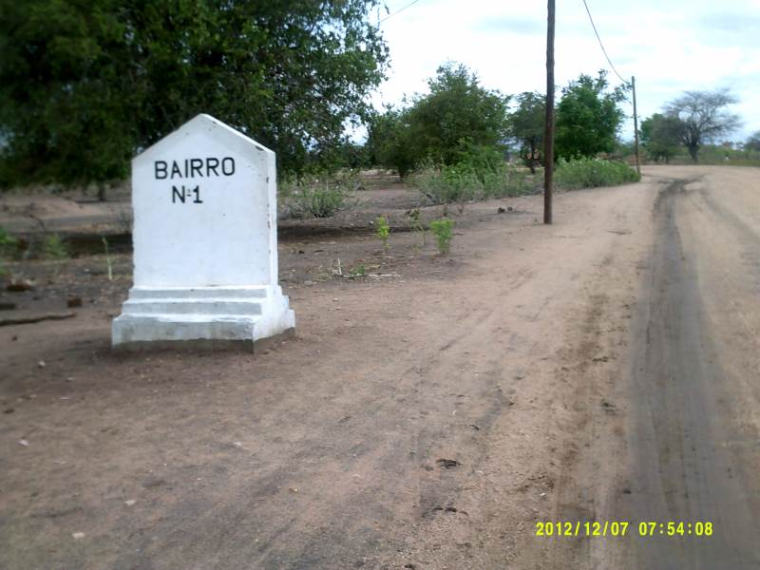
Highway

Slide 21
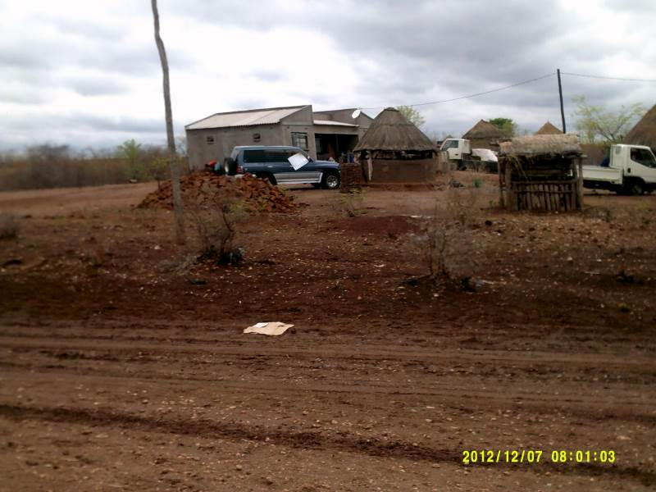
Big house

Slide 22
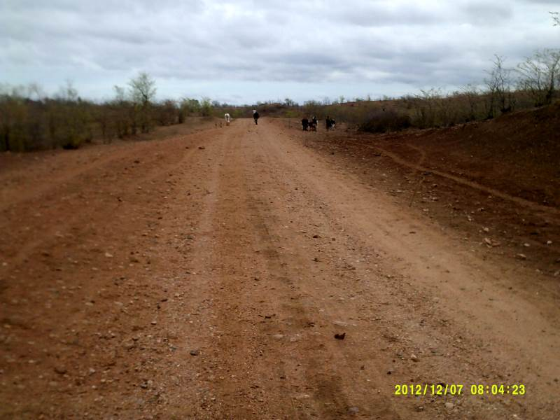
Herding cattle on highway
Just watch out for donkey carts

Slide 23
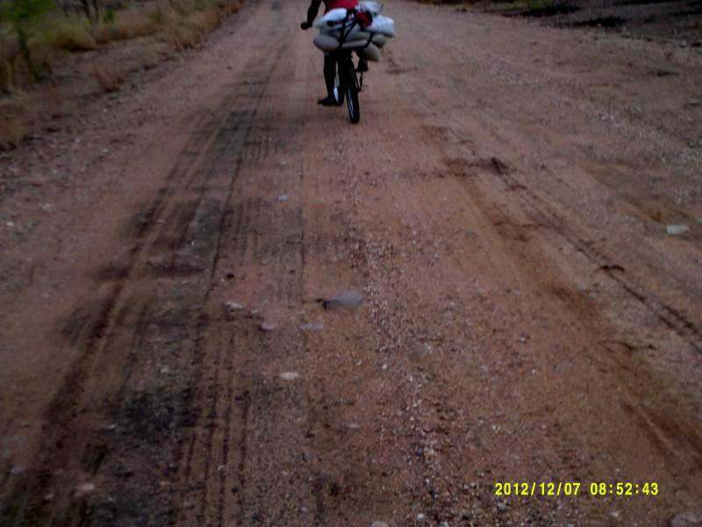
Transporting maize to mill

Slide 24
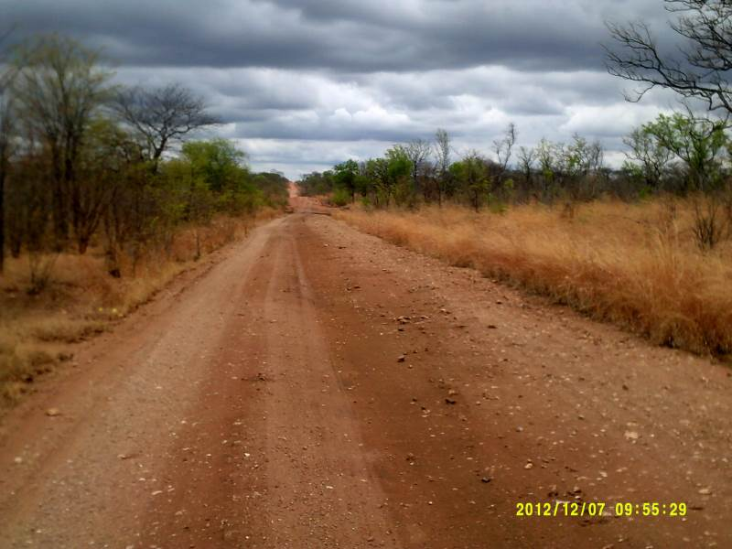
Nice clouds

Slide 25
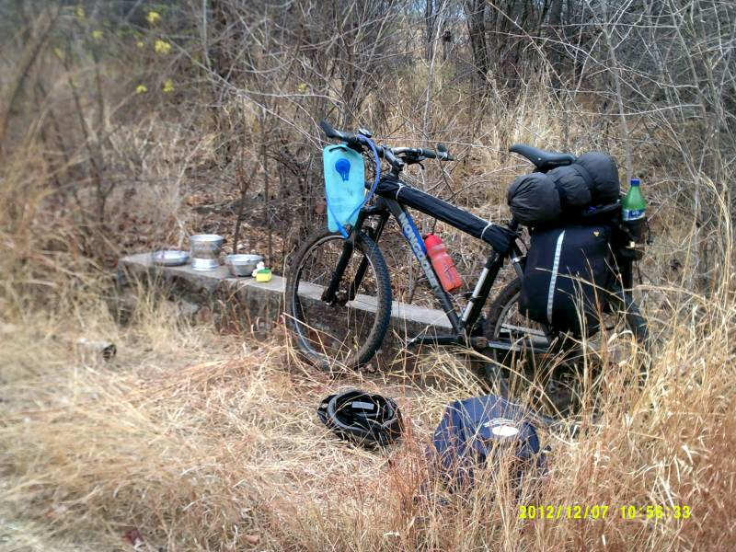
Cooking breakfast or almost lunch

Slide 26
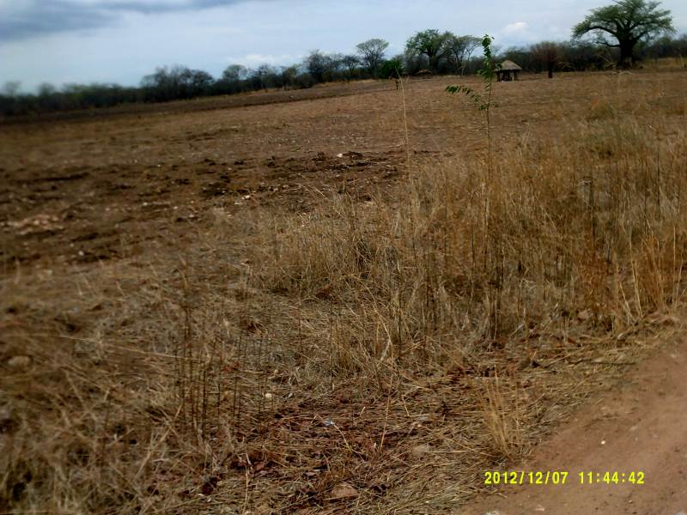
No till planting with shade

Slide 27
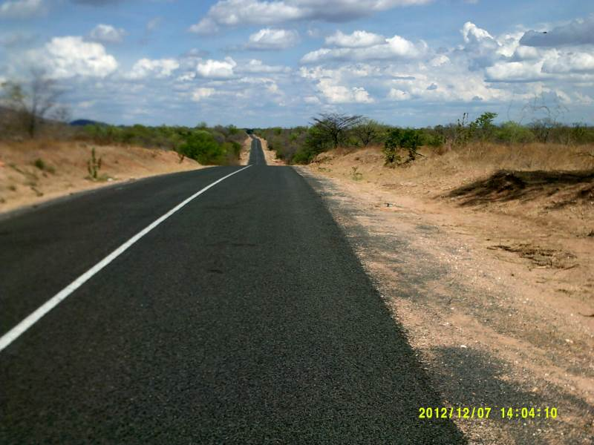
Good road build by Chines

Slide 28
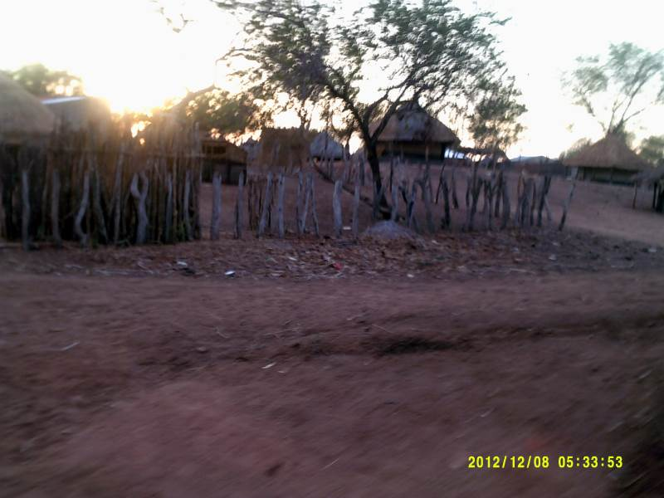
Morning after sleeping at village

Slide 29
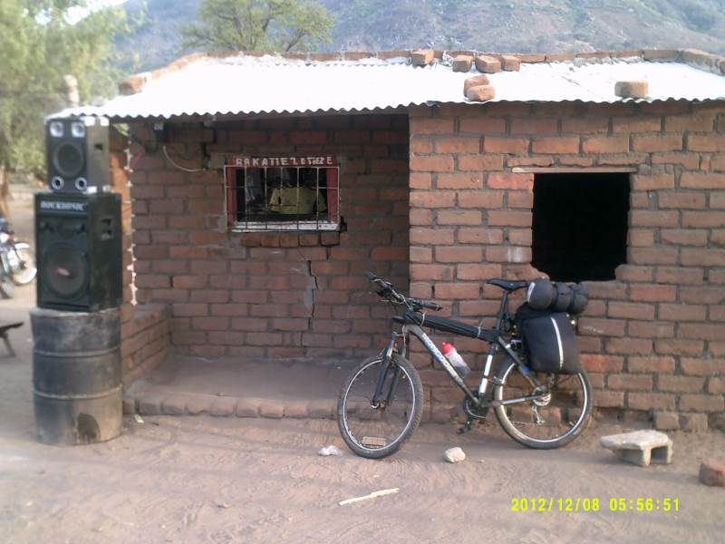
Big shop

Slide 30
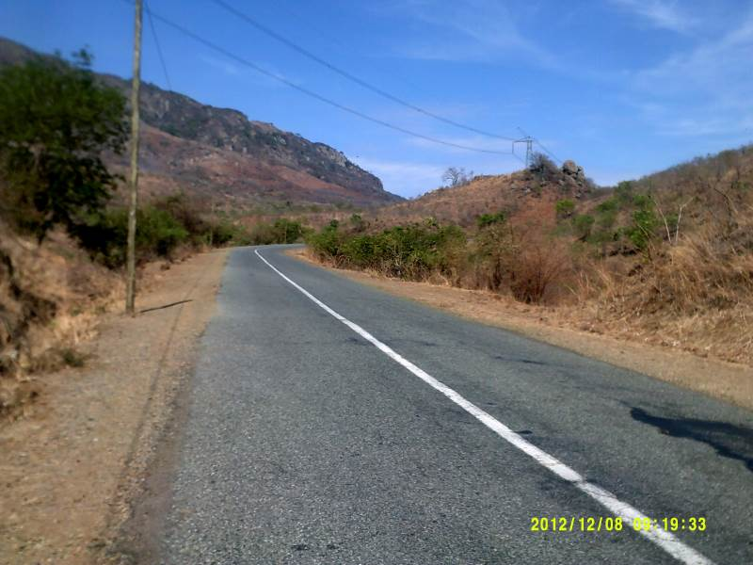
Big hills up to Cohora Bassa

Slide 31
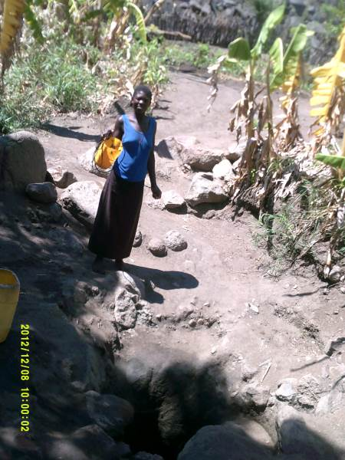
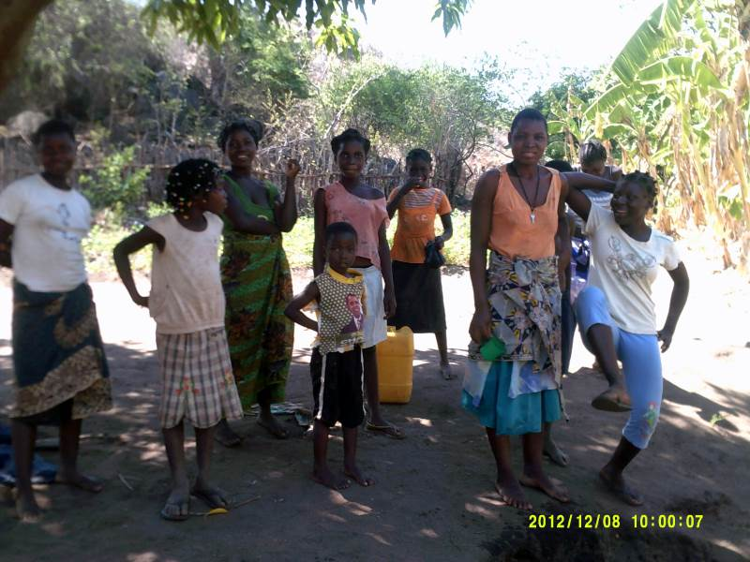
Getting water

Slide 32
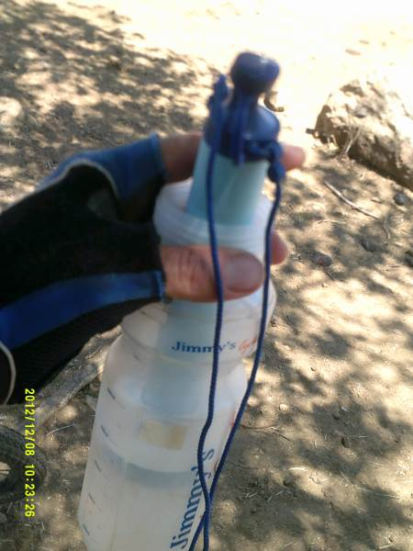
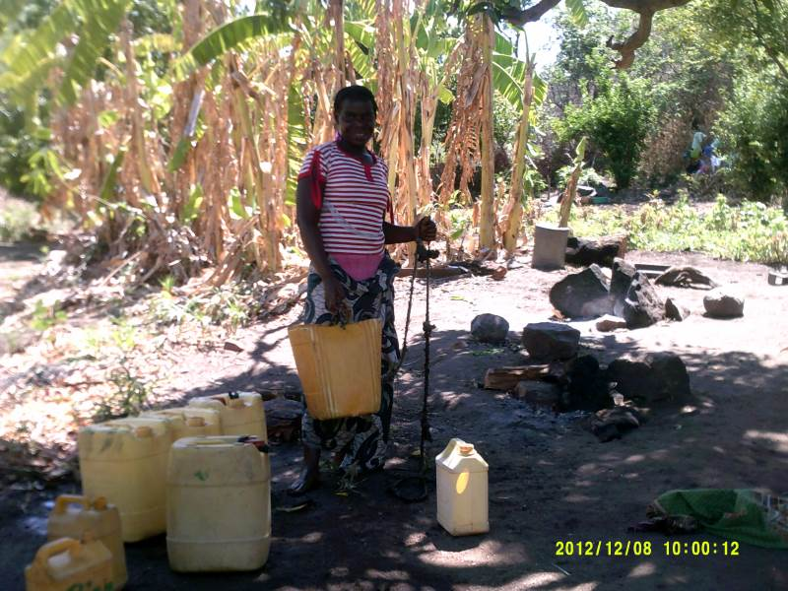
Safe water to drink

Slide 33
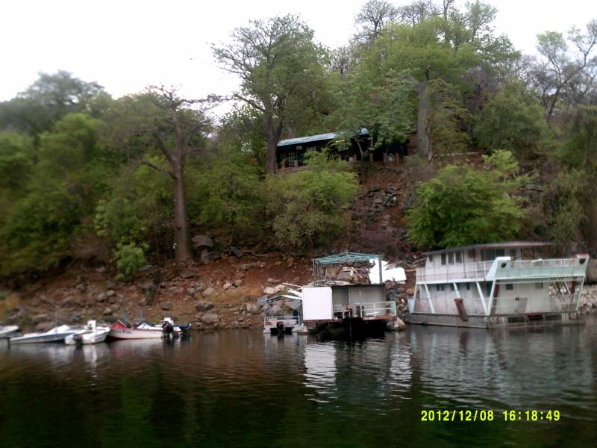
Ugezi Tiger fishing lodge

Slide 34
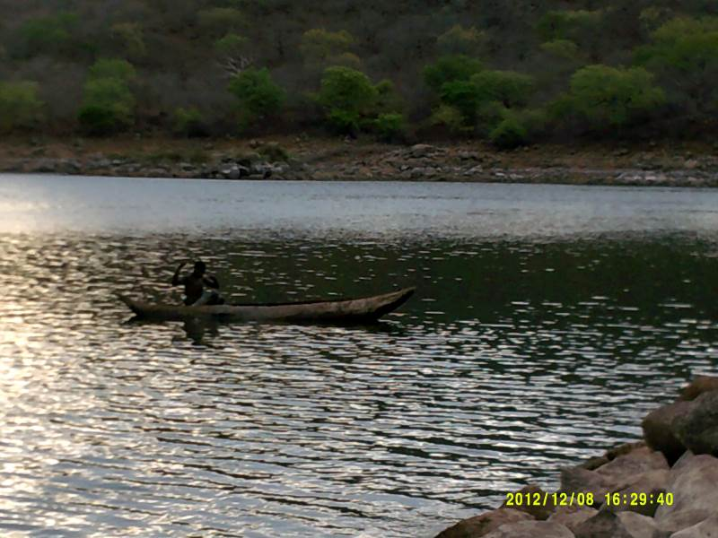
Fisherman on Cohora Bassa

Slide 35
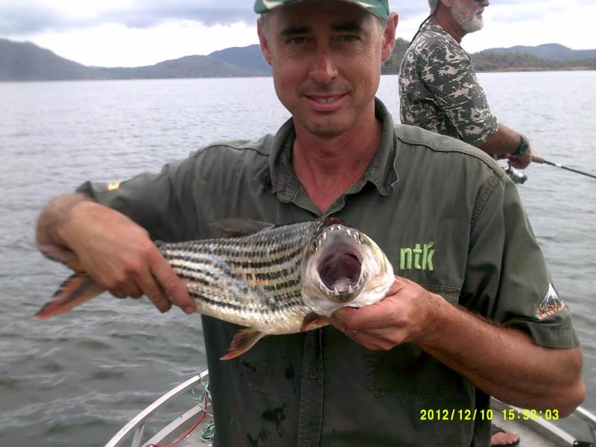
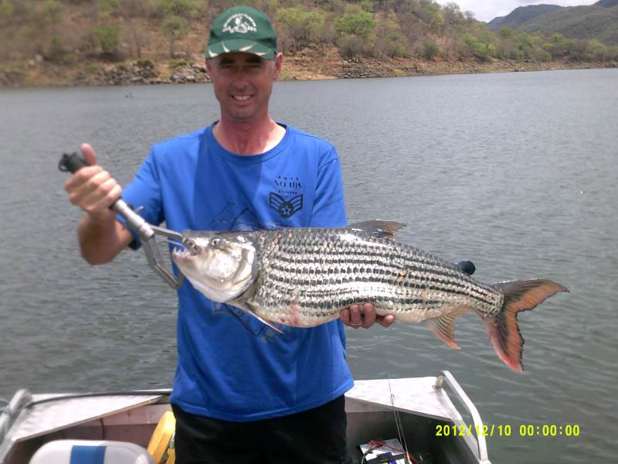
Beginner fisherman

Slide 36
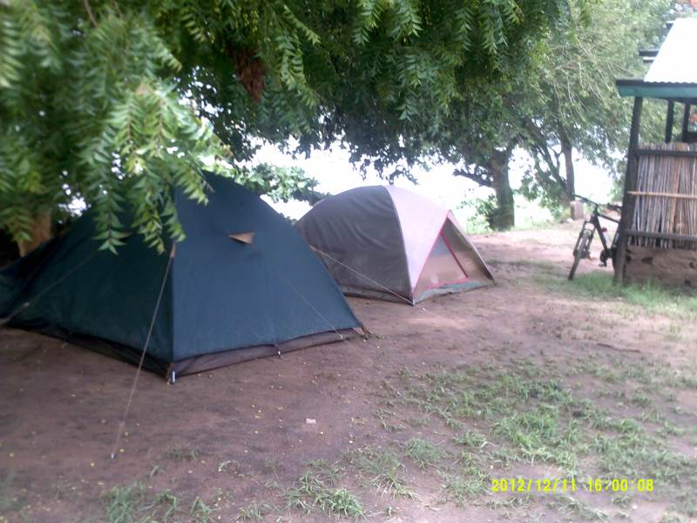
Bad camp site at Tete

Slide 37
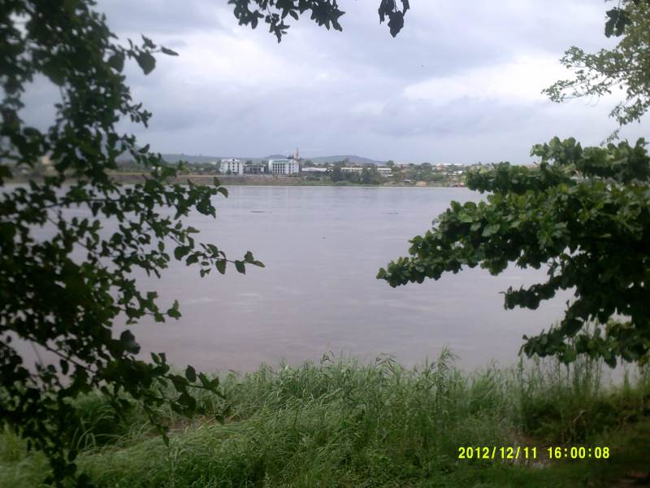
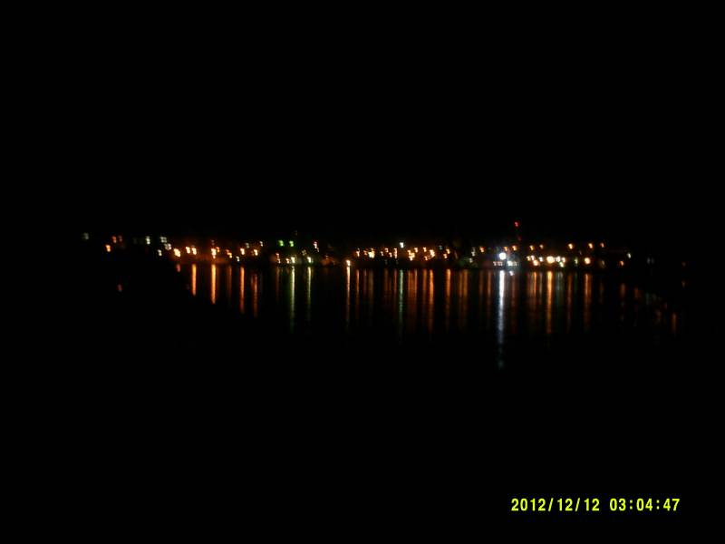
Tete

Slide 38
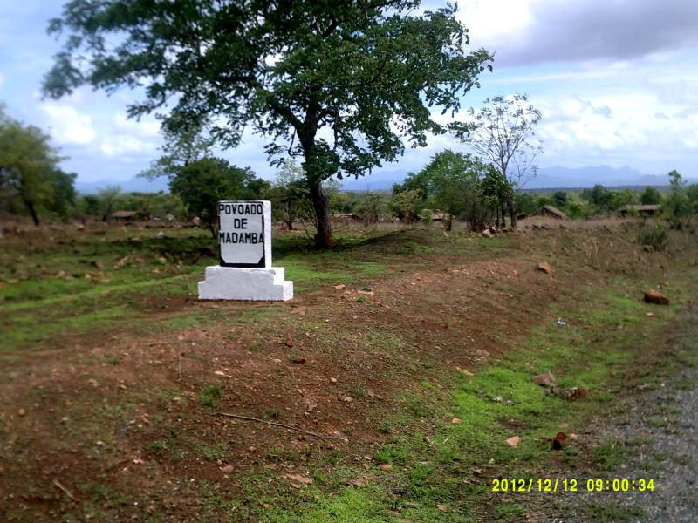
Village where turned east

Slide 39
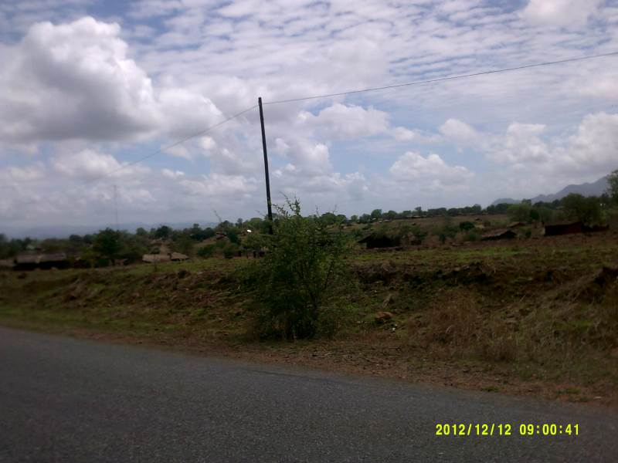
Same village with fields

Slide 40
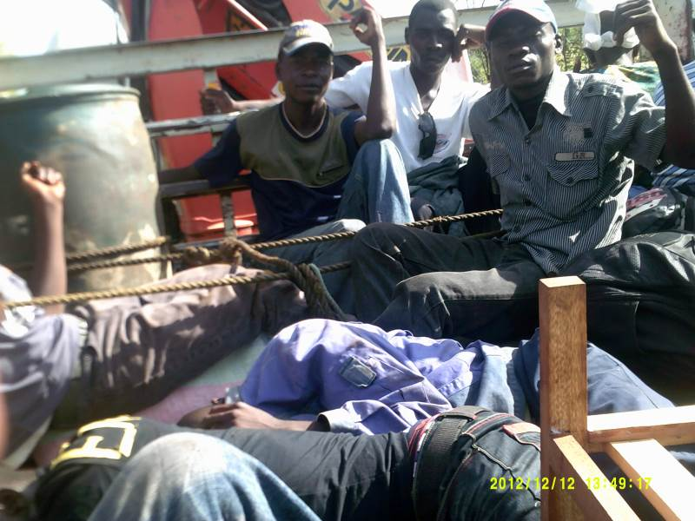
Took a ride with a truck

Slide 41
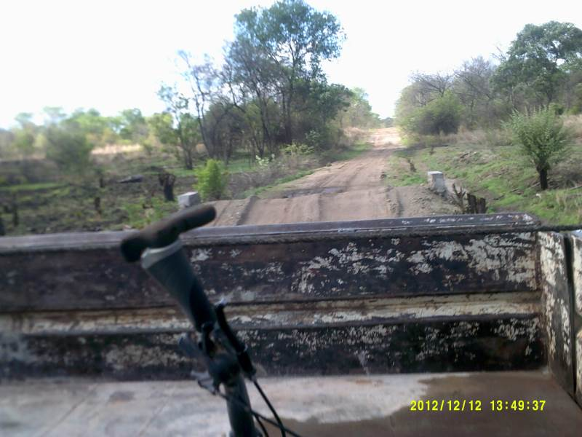
Eight hours of this road

Slide 42
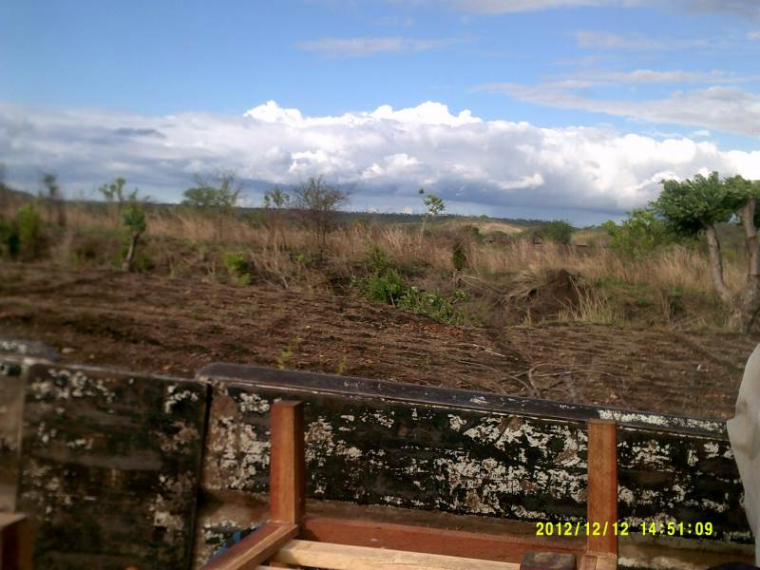
Planting no till+cotton

Slide 43
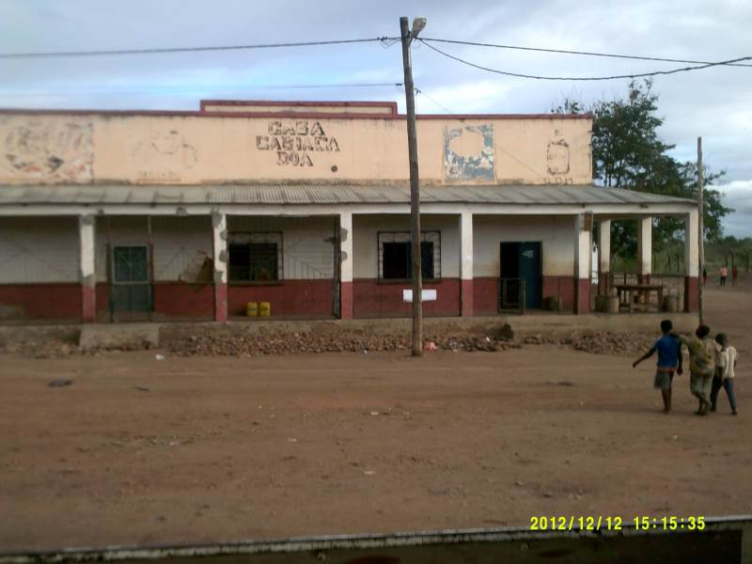
Town DOA

Slide 44
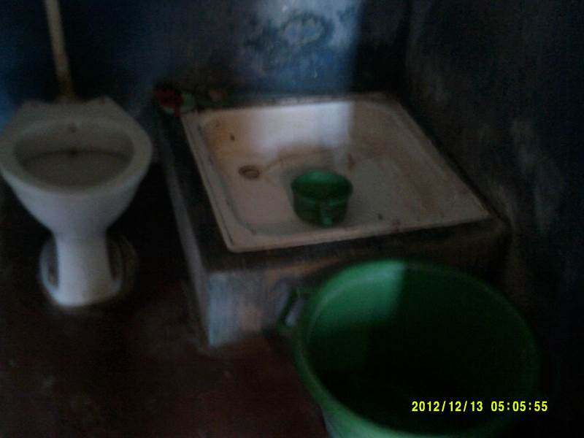
Bathroom at night accomidation

Slide 45
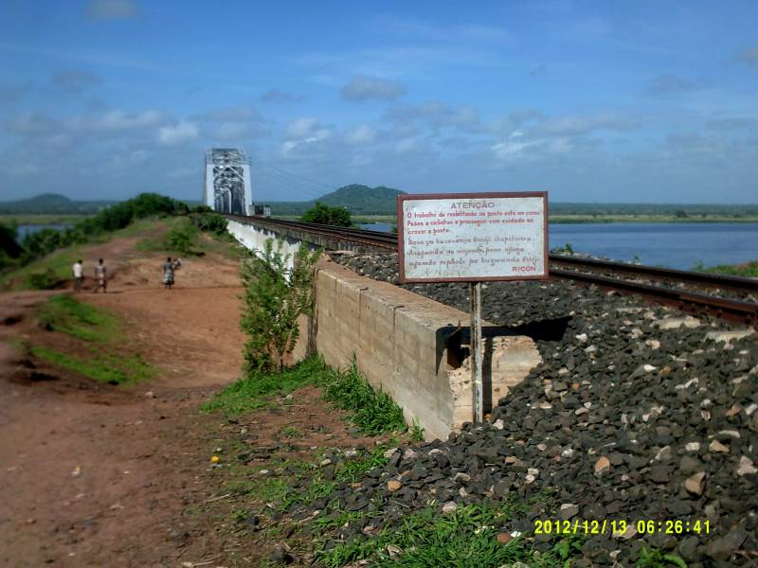
3.4km bridge Muturara to Sena

Slide 46

Walkway

Slide 47

Road to Cia

Slide 48

mphingwe Lodge

Slide 49

Hospital and school and another building

Slide 50

Modes of transport

Slide 51

Forest where logging occurs

Slide 52

Villages and towns abandoned

Slide 53

Bicycle transport

Slide 54

Rain came in

Slide 55

Beira Beach

Slide 56

Samora Macheal

Slide 57

Light house on north beach

Slide 58

Ruins on beach

Slide 59

Road to Ria Savane

Slide 60


River crossing to lodge

Slide 61


Ria Savane lodge

Slide 62


Ria Savane beach

Slide 63


Budget travel

Slide 64


Lodge

Slide 65

Airport Beira

Slide 66

Taxi to Johannesburg

Slide 67

Meet me at airport

Slide 68


Slide 69


Slide 70


